Slide 1
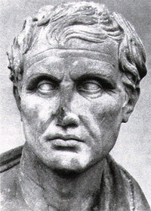
The Accusative Case
1st: -am, -as
2nd: -um, -os
2nd neuter: -um, -a
3rd: -em, -es
4th: -um, -us
4th neuter: -u, -ua
5th: -em, -es

Slide 2
Accusative of MOTION TO
1. Also known as the accusative of “Limit of Motion”
2. This accusative is used:
With names of towns, small islands, and peninsulas
With domum, domos, and rus
(Other designations of place require an added preposition, such as “ad”)
3. HOWEVER in poetry the accusative of any noun denoting a place can be used without a proposition to express “motion to”
4. Example: Romam veni: I came to Rome.

Slide 3
Accusative of TIME DURATION
This accusative is pretty self explanatory
2. Emphasis is sometimes add by using the preposition “per”
3. Example: Quadraginta annos vixit: He lived for forty years.

Slide 4
Accusative of EXCLAMATION
This accusative is usually modified by an adjective
Example: Me miserum: Ah, wretched me!

Slide 5
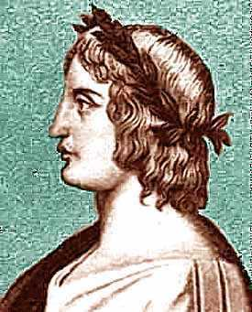
Prepositions with the Accusative
Accusative of motion to:
Designations of place (other than with towns/small islands/peninsulas or domum/domos/rus) take the preposition “ad” or “in” to denote limit of motion
Ex: ad Italiam venit … He came to Italy
OR
Thurios in Italiam pervectus … carried to Thurii in Italy
2. When domus means “house” it takes a preposition, usually “in”
Ex: in domum veterem remigrare … to move back to an old house
Accusative of time duration:
Emphasis is sometimes added by using the preposition “per”
Ex: per biennium laboravi … I toiled throughout two years

Slide 6
SOURCE:
New Latin Grammar by Charles E. Bennett

